Slide 1
Health care facility design, construction and renovation

Slide 2
Learning objectives
Describe the role of infection prevention and control in construction/renovation projects.
Define engineering, environmental and work practice controls.
Explain the importance of the environment in infection prevention and control.
Identify potential building-related infection risks.

Slide 3
Time involved
50 minutes

Slide 4
Background
Recommendations for design, construction and renovation of health care facilities must be based on:
  experience
  assessing infection risks
  considering local resources
Published evidence is scarce
Notes:
The influence of design and construction on healthcare-associated infections (HAI) is difficult to evaluate. Secondary variables such as microbial counts in air or water are often used for bench-marking. Published evidence on best practices is scare.
Recommendations from infection prevention and control is based on one’s experience, an assessment of potential infection risks to patients and a consideration of local resources.

Slide 5
Infection risks
Distance between beds less than 1 meter
Shortage of washing/changing facilities for staff
Overcrowding
Fungal spores in building materials and air
Contaminated water
Notes:
The risk of infection in patients due to building features is related to the proximity of patients to each other, ease of carrying out best practices by staff, and air/water quality. The risk is influenced by the following building-related issues:
Distance between beds less than 1 meter
Shortage of washing/changing facilities for staff
Overcrowding
Fungal spores in building materials and air
Contaminated water
Construction as an independent risk factor for HAIs is not clear.

Slide 6
Factors: spread of infection -1
Numbers of patients and staff
Numbers and types of procedures and examinations
Available space
Numbers and types of rooms
Number of beds in a room
Notes:
Modes of transmission of infection include airborne, contact and droplet. The design/construction factors that are involved in the transmission of infection include:
Numbers of patients for the space allotted
Numbers of staff to be able to perform best practices
Numbers and types of procedures/examinations for the space allotted
Available space
Numbers and types of rooms
Number of beds in a room

Slide 7
Factors: spread of infection -2
Floors and surfaces
Water, electricity, and sanitation
Ventilation and air quality
Handling of used and unused medical equipment
Handling of food, laundry, and waste
Notes:
Additional design/construction issues that influence transmission of infection include:
Floors and surfaces
Water, electricity, and sanitation
Ventilation and air quality
Handling of used and unused medical equipment
Handling of food, laundry, and waste

Slide 8
Important design issues
Heating, ventilation, air-conditioning
Sinks, alcohol hand rub, soap, paper towels
Sharps and waste disposal
Walls, floors, furniture
Utility rooms for cleaning soiled items
Storage for patient care items and PPE
Bathrooms for patients, staff
Notes:
Recommendations for health care design and construction must be based on experience and applicability, considering local resources and cultural conditions, together with a review of current scientific literature. Important factors include design, ventilation, patient placement or relocation, and effective construction barriers to protect susceptible patients from airborne pathogens.
Design issues to help prevent spread of infections include:
Air and water quality, e.g., heating, ventilating, and air-conditioning systems
Escombe* investigated the influence of natural and mechanical ventilation and found that in countries with limited resources, window ventilation may be effective to prevent the spread of tuberculosis.
Fixtures, e.g., sink numbers, placement of hand washing stations; dispensers for hand hygiene products and associated materials (soap, waterless alcohol-based hand rub, paper towels, lotion, and similar items)
Sharps and waste disposal placement
Surfaces, e.g., ceiling tiles, walls, counters, floor coverings, and furnishings
Utility rooms, e.g., soiled, clean, instrument processing
Storage areas, including patient care supplies and personal protective equipment
Patient placement and basic room design, including bathrooms for patients and staff
*Escombe AR, Oeser CC, Gilman RH, Navincopa M, Ticona E, Pan W, et al. Natural Ventilation for the Prevention of Airborne Contagion. PLoS Med 2007; 4: 309-317.

Slide 9
Basic construction of a sterilisation unit
Notes:
This is an example of how to set up a sterilisation unit. The flow should always go from dirty/soiled area to clean/sterile area.
Similar concepts can be used for other health care areas.

Slide 10
Numbers and types of rooms
Maximum 40 beds on a ward
Aim for more rooms with fewer patients
Single rooms for infectious patients
Provide space for visitors/helpers
Provide space for staff
Notes:
Patient care units or wards may be overcrowded. A maximum of 40 beds on a ward should not be exceeded because of very long distances for the staff to walk. There may be more than one baby/child in a cot/bed. Visitors often sleep with the patient. Therefore, during renovation the aim should be more rooms with fewer beds in each. Single rooms for isolating infectious patients should be available, especially in countries where communicable diseases are endemic.
Provide space for visitors, patient helpers, and staff. Yu* conducted a case-control study in Guangzhou and Hong Kong, China, during the SARS epidemic of 2003 on 124 wards in 26 hospitals. Cases were on wards with super-spreading events of SARS; controls were on wards with SARS cases admitted but without HAI outbreaks. They found six significant risk factors, two of which were influenced by construction: distance between beds of <1 m and availability of washing or changing facilities for staff .
*Yu IT, Xie ZH, Tsoi KK, Chiu YL, Lok SW, Tang XP, et al. Why did outbreaks of severe acute respiratory syndrome occur in some hospital wards but not in others? Clin Infect Dis 2007; 44(8):1017-25.

Slide 11

Hand hygiene
Alcohol based hand rub
Liquid soap and paper towels
Reusable dispensers must be maintained and cleaned before refilling
Wash basins
Notes:
Alcohol-based hand rubs (ABHR) are critical, especially if wash basins are limited and water supply interrupted. There should be enough dispensers for ABHR, liquid soap, and paper towels for staff use. Reusable dispensers must be maintained, cleaned and then refilled. Wash basins should be readily available.

Slide 12
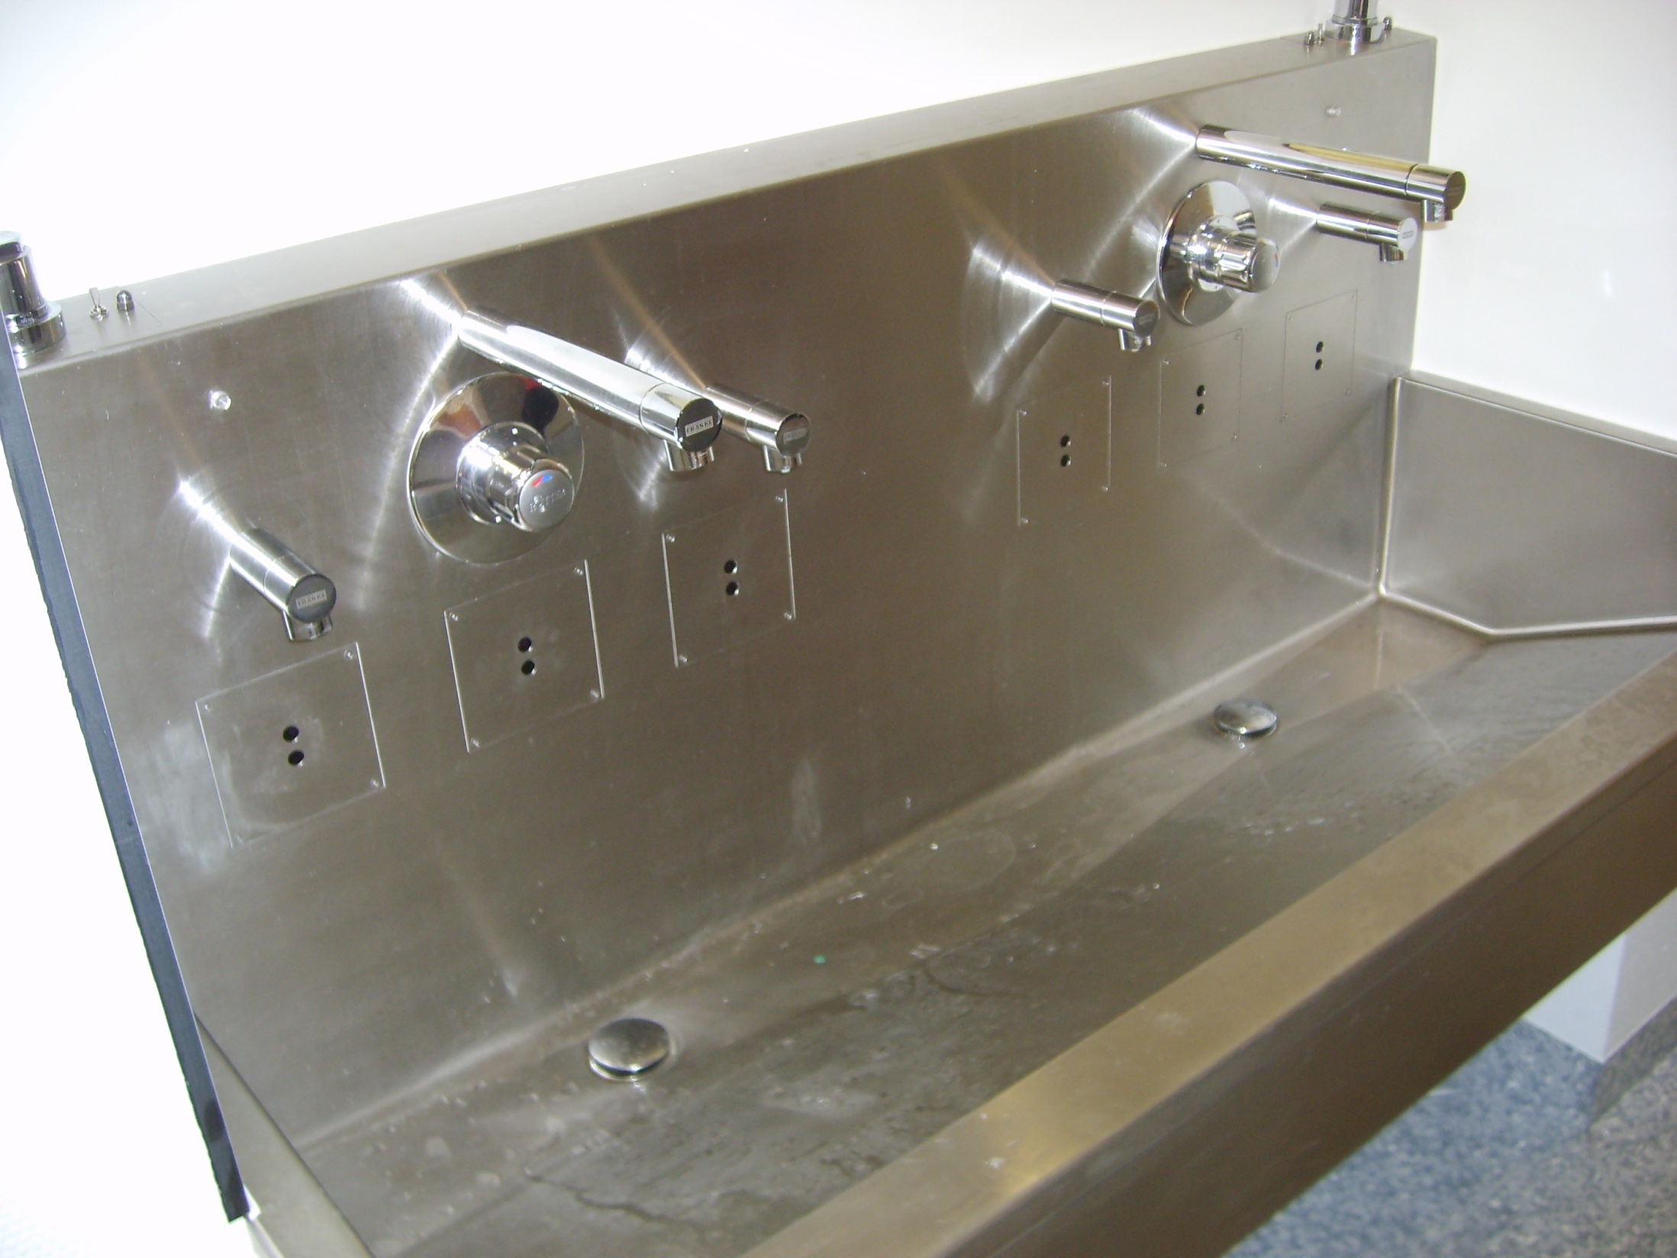
Only single use bottles for disinfectants and fluid soap should be used
Use mechanical water outlets instead of contact-less types– these are often colonised by water bacteria because of construction issues
Notes:
If a dispenser needs to be reused, it must be cleaned and filled with fresh product when empty. Liquid soap/alcohol-based hand rub must never be added to a partially full dispenser.

Slide 13
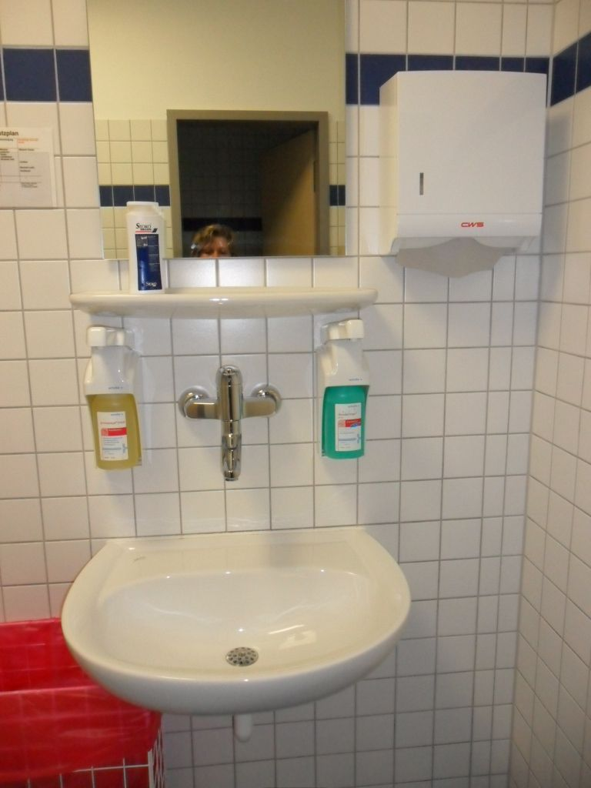
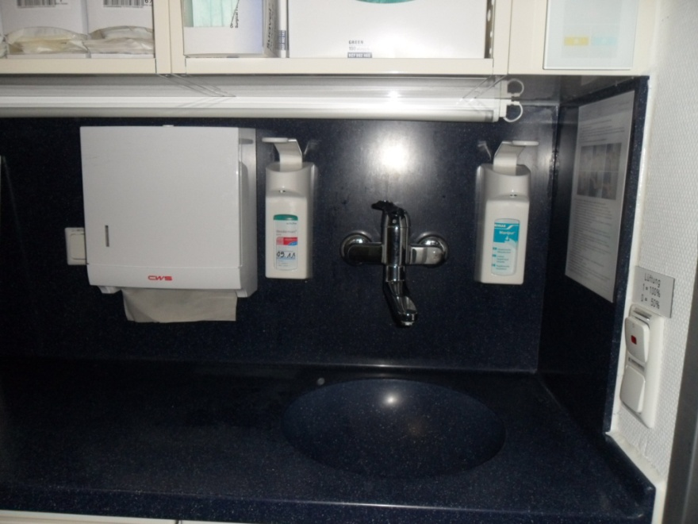
Dispenser Placement
Notes:
Soap and paper towel dispensers should be convenient to the sink itself.

Slide 14
Floors and surfaces
Surfaces should be smooth:
  No unlacquered wood
  No carpets
  No cracks
Prevents collection of moisture, secretions or chemicals
Notes:
Surfaces and furniture need to be cleaned and disinfected to prevent indirect contact transmission. Surfaces should be smooth for ease in cleaning; this means no un-lacquered wood and no carpets. The goal is to prevent collection of moisture, microorganisms from secretions and excretions, and chemicals.

Slide 15
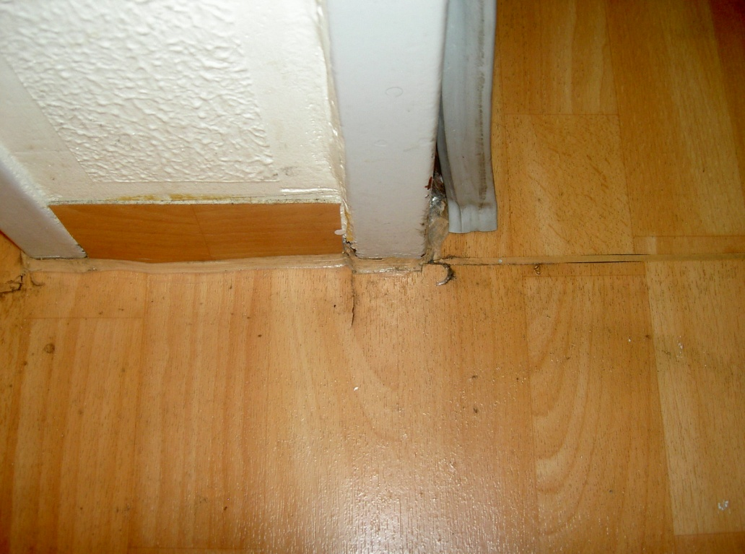
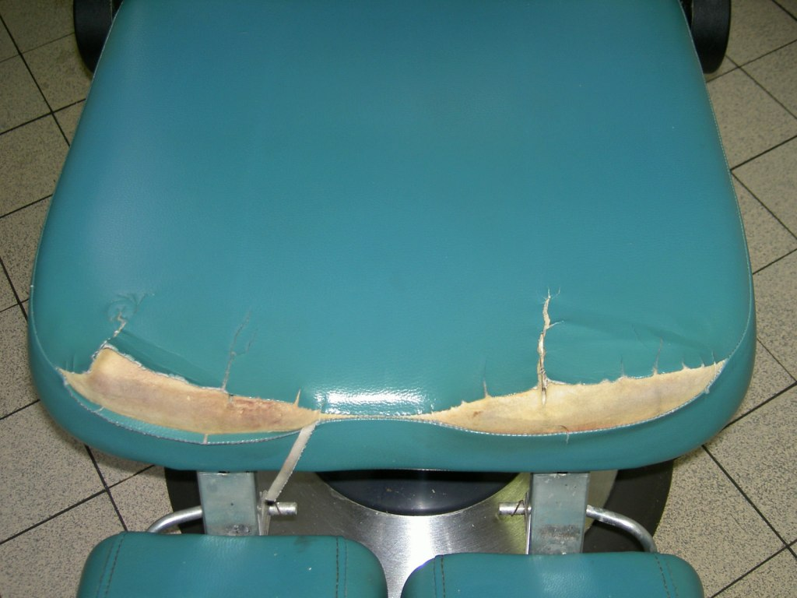
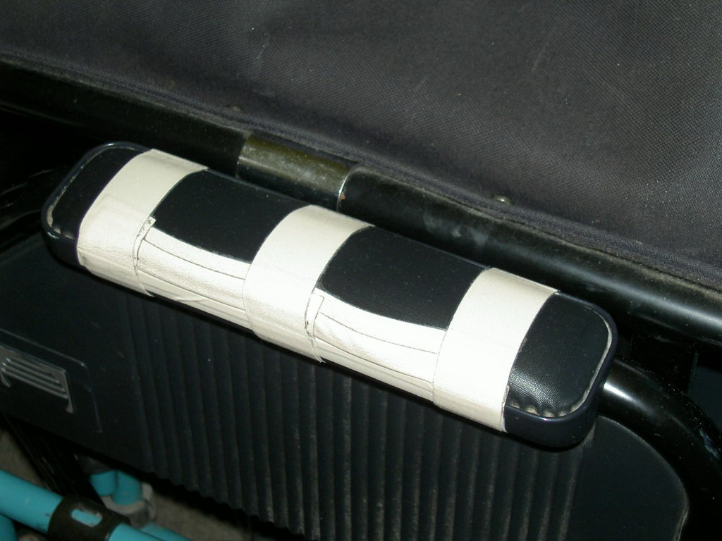
  Surfaces must be able to withstand cleaning agents and disinfectants
  Usually disinfectants are more corrosive than cleaning agents
Notes:
Surfaces in healthcare facilities must be easily cleaned and able to withstand harsh chemical use. Many disinfectants will harm equipment or surfaces over time.

Slide 16
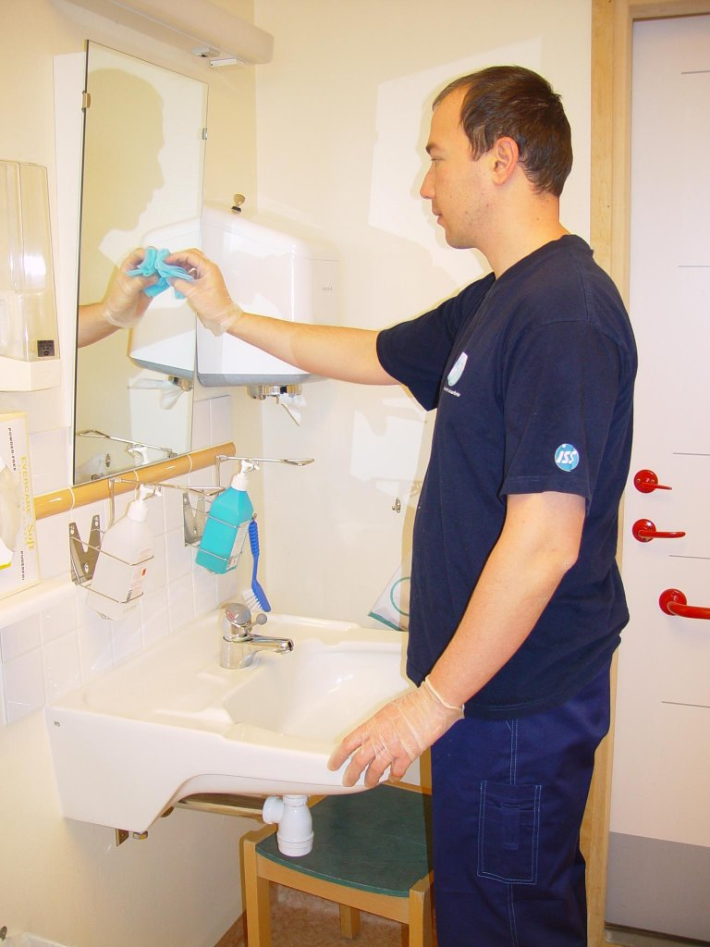
Water, electricity and sanitation
Controlled and safe drinking water
Enough toilets for both sexes
Clean toilets daily
Electricity 24 h/day
Notes:
Drinking water must be controlled and regularly checked for quality and safe levels of contaminants. Every ward should have enough toilets for both sexes. Toilets and washbasins must be maintained and cleaned daily. Showers should be available. Clean water supply and electricity should be available 24 hours a day.

Slide 17
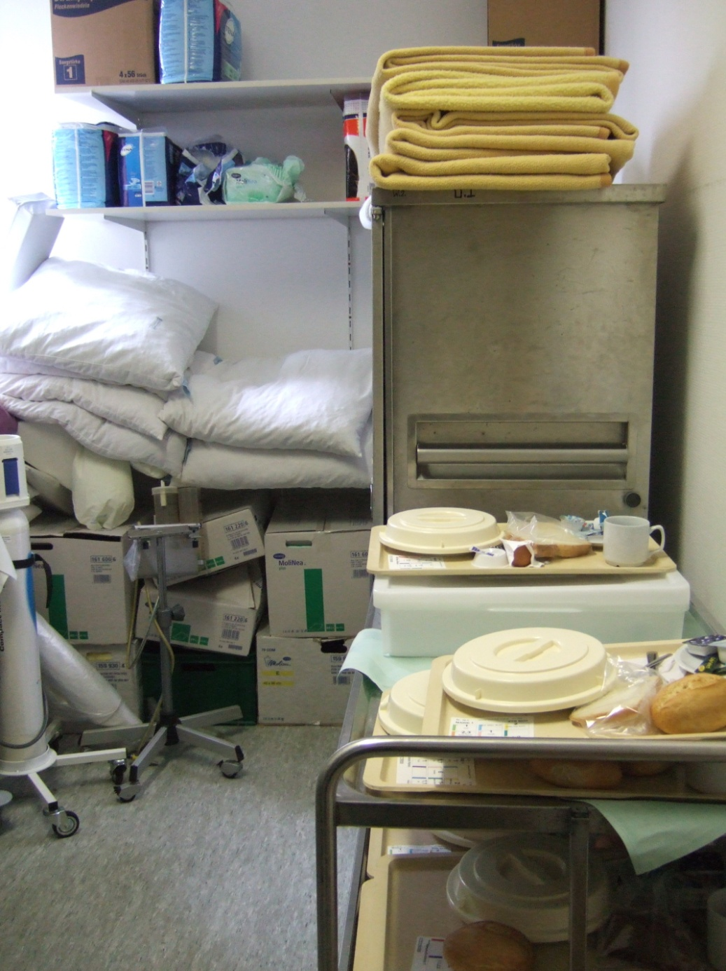
Don´t store prepared food in storage rooms

Slide 18
Ventilation and air quality
  Proper ventilation is necessary to prevent airborne infection
  Natural ventilation if climate appropriate
  Mechanical ventilation must be well maintained
  Filters must be serviced
Notes:
Natural ventilation is addressed in the World Health Organization’s Policy on TB infection control in health-care facilities, congregate settings and households 2009. The choice of ventilation system should be based on facility assessment and informed by local climatic and socioeconomic conditions. Practical details for design are outlined in the WHO’s monograph, Natural ventilation for infection control in health-care settings. For further reading, see SIG Construction recommendations at http://theific.org/sigs3.asp

Slide 19
Barriers During Projects
Barriers should be selected to seal off the area during dust-producing activities
Examples of barriers include:
  Closed doors with duct tape applied over the frames
  Drywall room partitions with sealed seams
  Plastic barriers
Dismantle barriers/temporary partitions after cleaning the work area in a manner to avoid dispersing dust
Protect patient care equipment and supplies from dust exposure
Notes:
A risk assessment can be used to determine appropriate barriers. First determine the risk category for the area or adjacent areas to the renovation then match the risk category (low, medium, high, highest) with the planned construction project type and determine the class of barrier precautions. A check list for control process can be implemented with the infection control team.
Examples of charts to help with this assessment may be found at http://www.ihea.org.au/files/InfectionControlManual.pdf

Slide 20
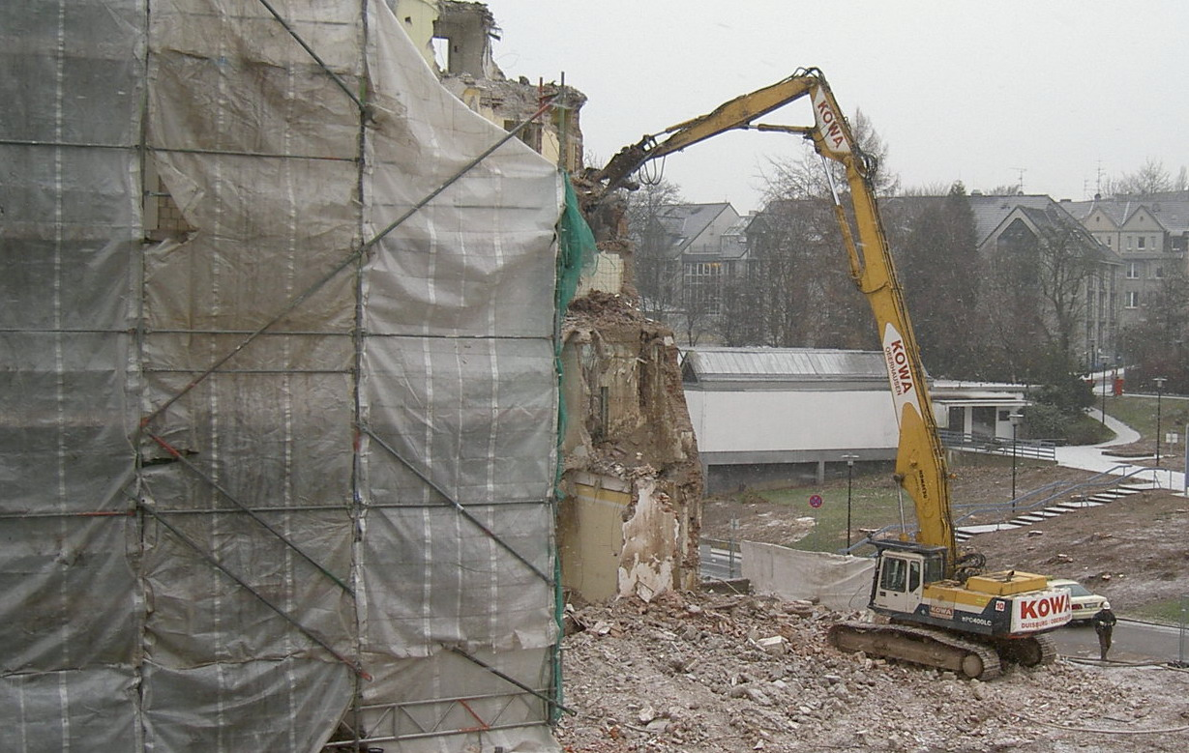
Deconstruction sheltered by plastic planes – less dust
Notes:
This is an example of the use of plastic sheeting to decrease dust. This type of plastic cover can be used during projects that are either outside or inside the building.

Slide 21
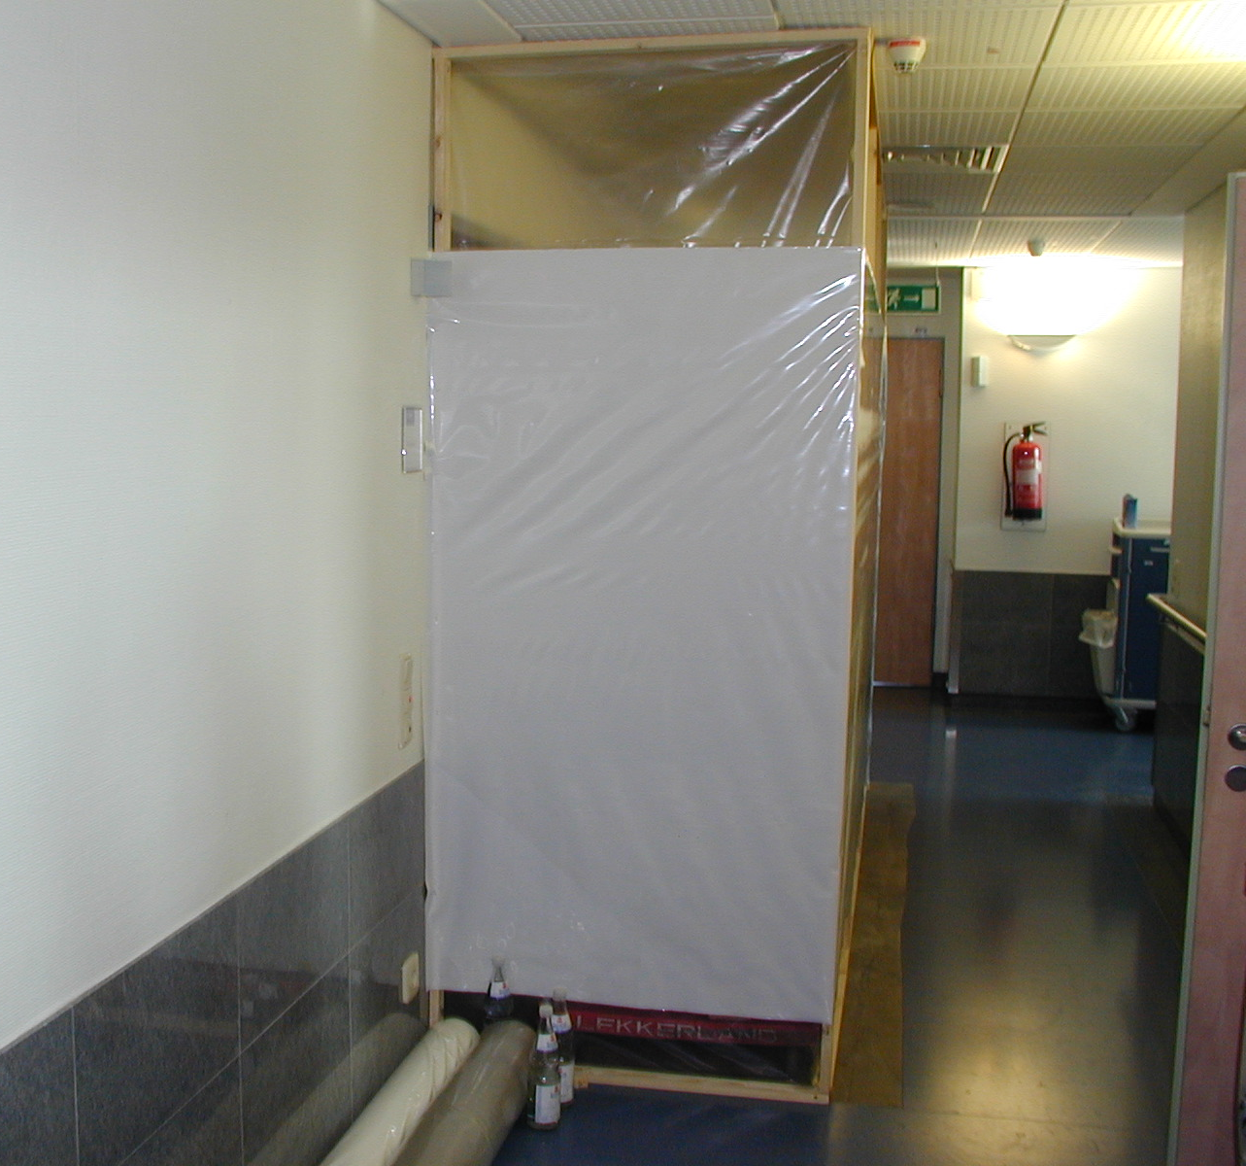
Good shielding and renovation in reduced pressure
Notes:
An example of use of plastic covering indoors. Patient, visitor, and staff traffic may need to be rerouted around construction and renovation barriers.

Slide 22
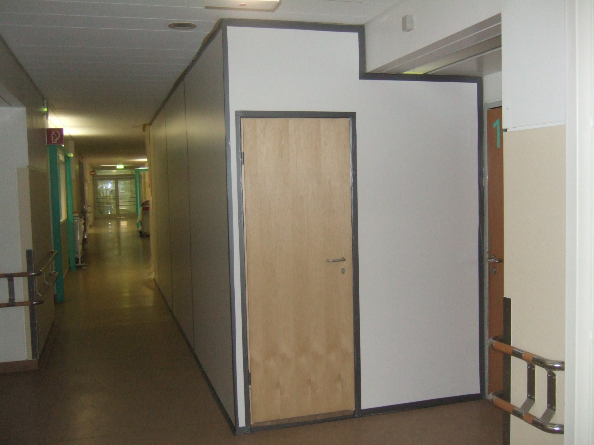
Renovation behind shielding
Notes:
An example of building temporary structures to provide dust protection. Again, it must be built properly so that dust cannot escape. The type of barrier used should be based on the setting and the potential for generating dust during the project.

Slide 23
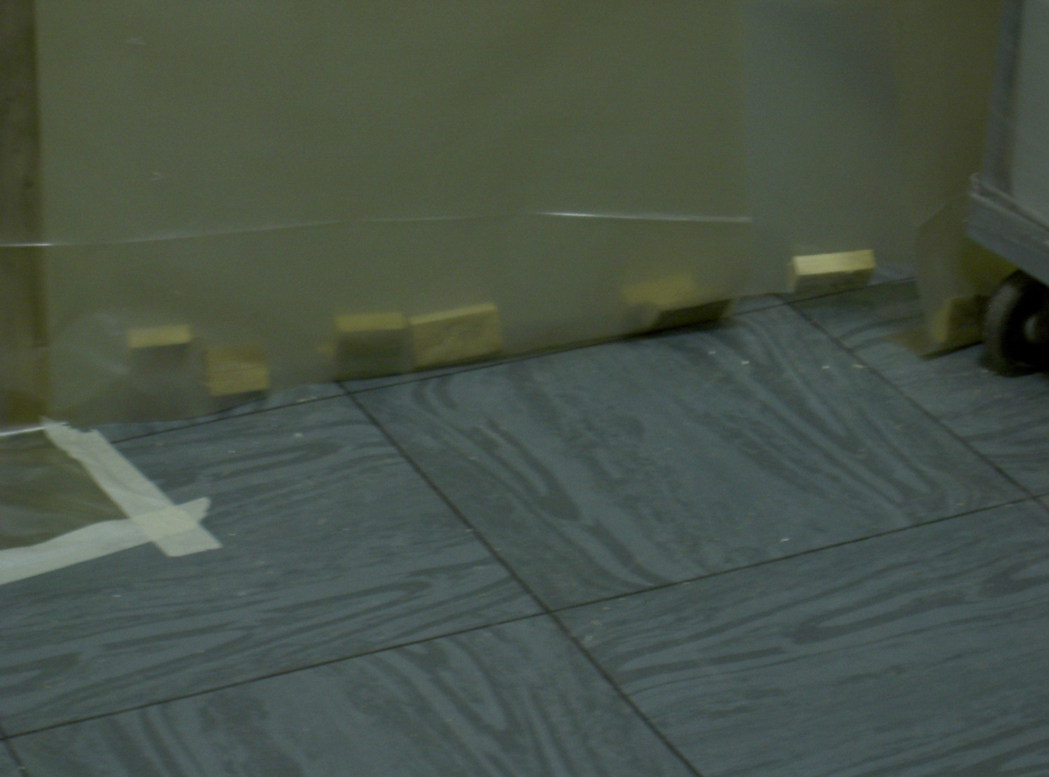
Insufficient shielding
Notes:
The use of plastic sheeting must be complete – that is, it must be sealed tightly so that dust cannot leak out.

Slide 24
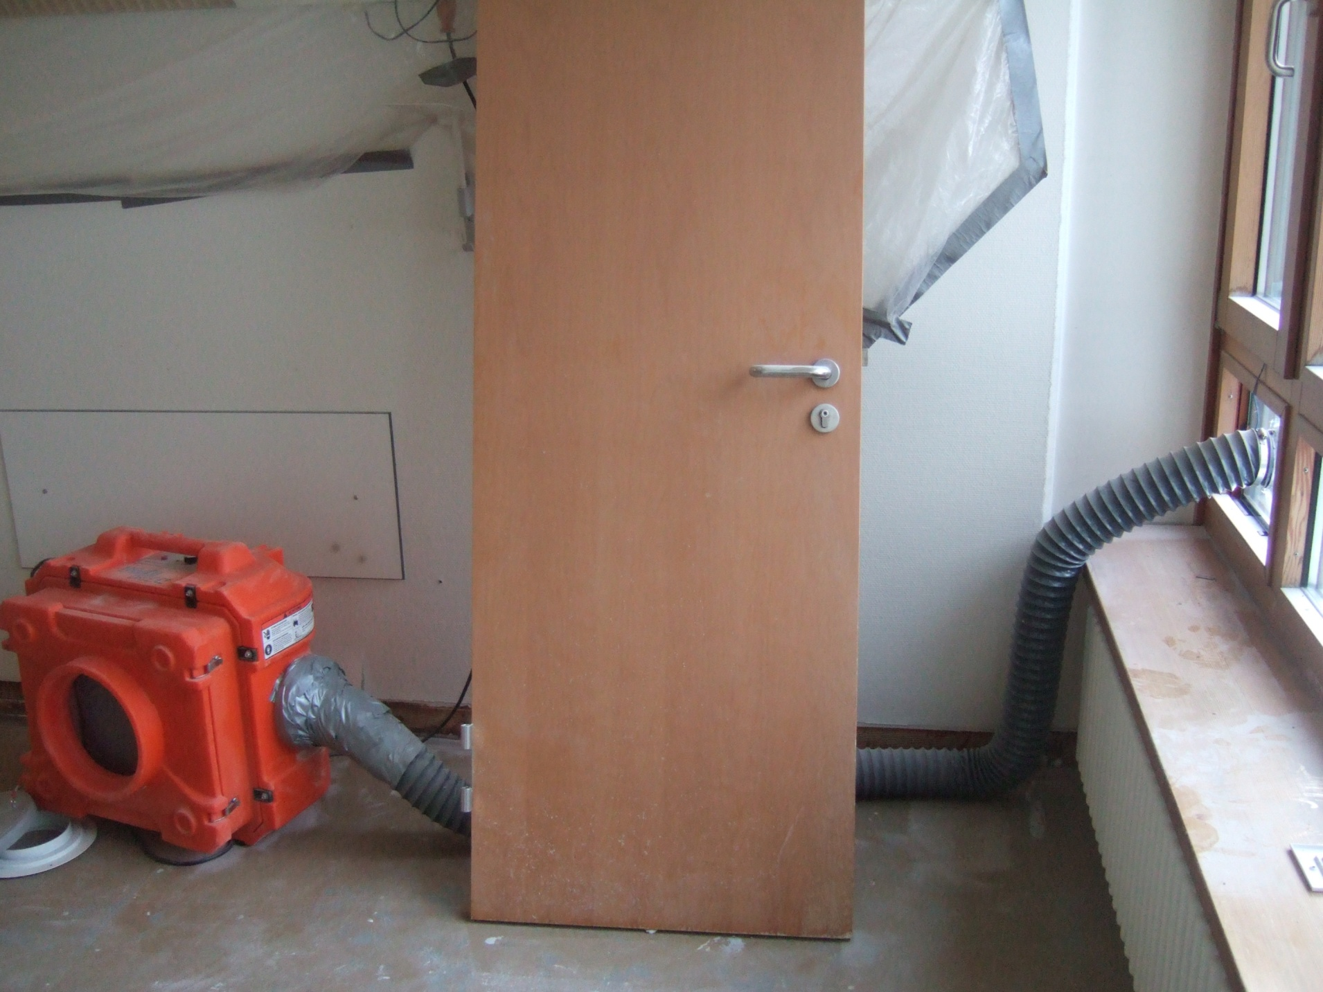
Producing low pressure for renovation
Notes:
Example of using a mechanical device to produce low/negative pressure in an area. Negative pressure in a work area will ensure that air will always flow into the space instead of out of the space.

Slide 25
Medical equipment
Separate clean and dirty procedures in designated areas
Use good cleaning and disinfection procedures for soiled items
  e.g., bedpans
Prepare infusions and injections in a separate clean room/area
Store clean medical devices in a defined place
  In closed lockers or cabinets
Notes:
Proper handling of used and unused medical equipment requires separation of clean and dirty procedures. Designated areas are needed, as well as good cleaning and disinfection procedures. Preparation of infusions and injections should take place in a separate clean room/area. Dirty procedures, such as cleaning of soiled bedpans, should be performed in another room. Clean medical devices should be stored in a designated room or a defined place. Wrapped, sterile goods should be stored in closed lockers or cabinets and not on open shelves.

Slide 26
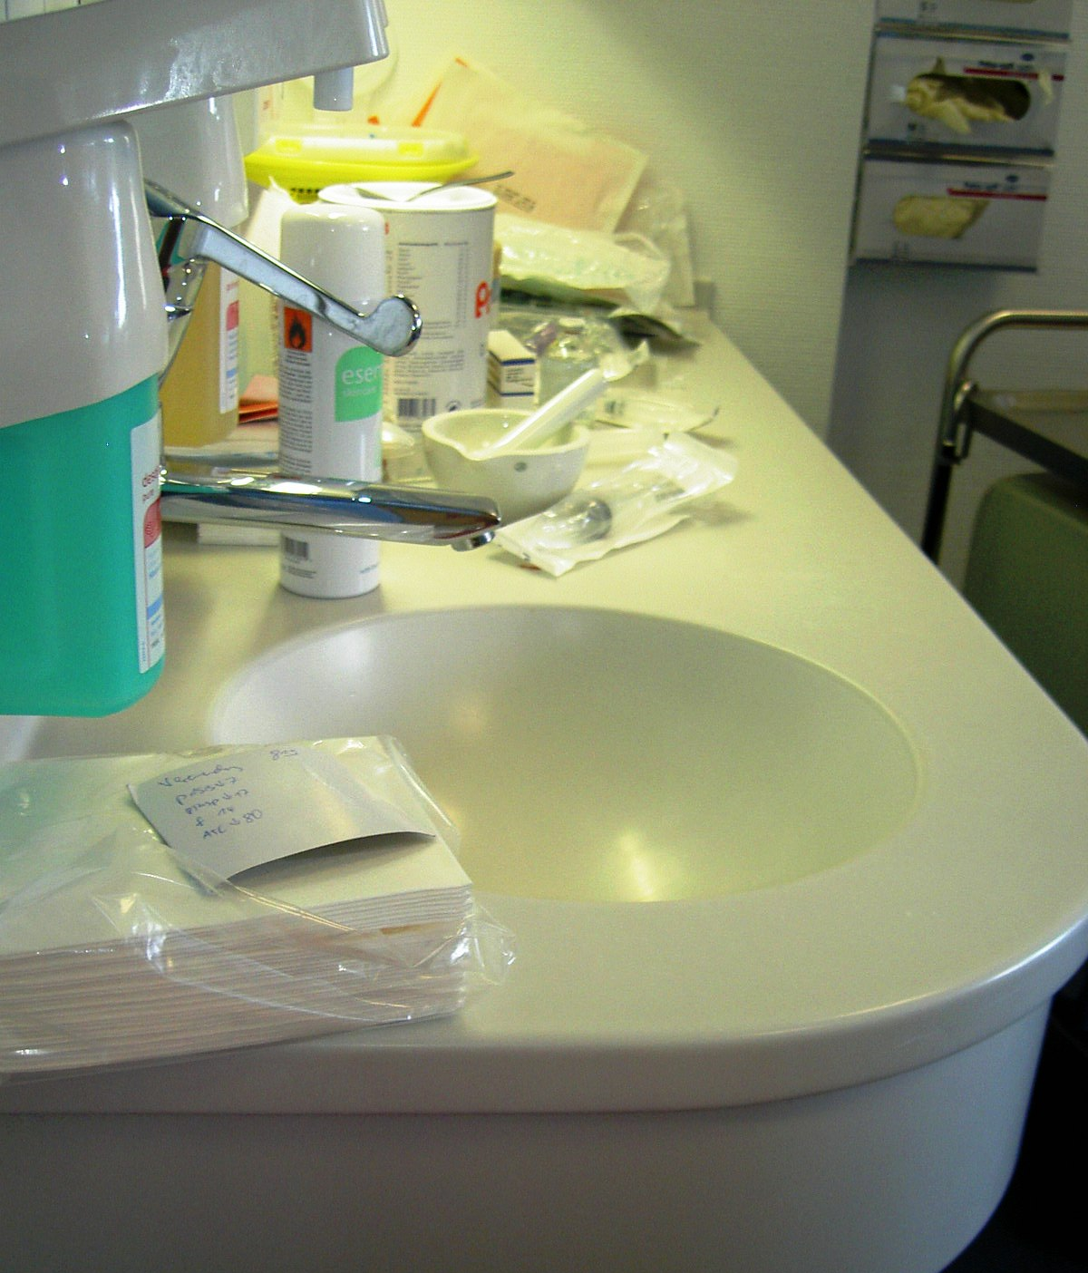
  Infusions and syringes should not be prepared besides sinks – risk of transmission of aerosols from water
  At least have a splash guard between sink and clean area
Notes:
At least have a splash guard between the clean area used for preparation and the sink. This will decrease the potential for water contamination through aerosols.

Slide 27
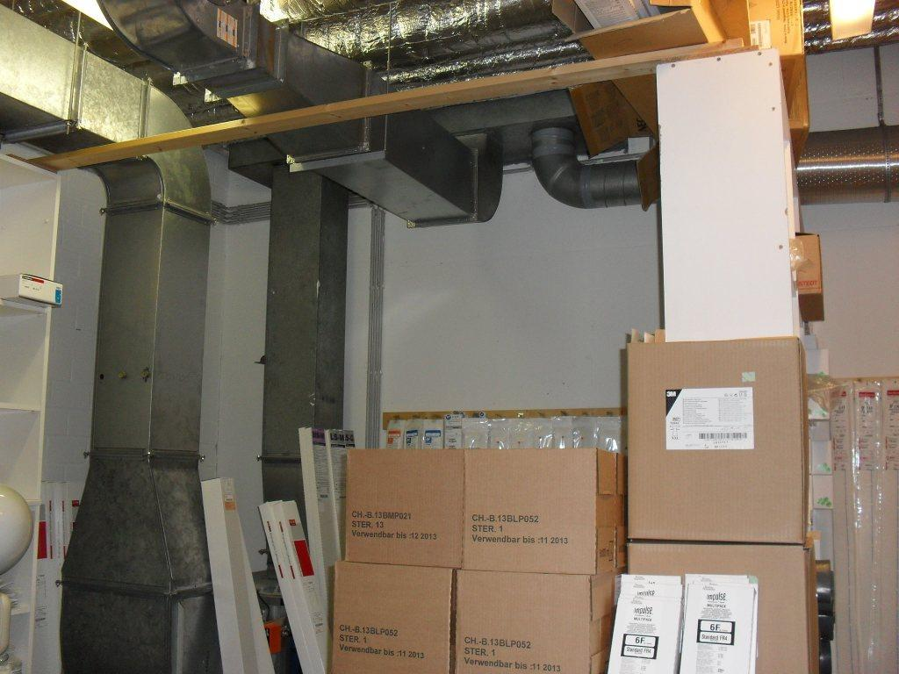
  Incorrect storage of sterile products (these are heart catheters)
Notes:
Storage areas must be clean, dry, uncluttered, and free of dust. All sterile items must be stored in a manner that maintains the integrity of the item and protects it from potential contamination from splash, dust, tears, etc. Supplies should be stored with adequate space to prevent the item from being torn or damaged. Supplies should be handled and stored in a manner in which they are unlikely to fall, be crushed, bent, compressed, punctured by other items, be exposed to moisture, or have contact with surfaces or areas contaminated or potentially contaminated with body fluids.

Slide 28
Food, laundry and waste
Prepare food for patients in a clean kitchen by trained staff
Hot food must be eaten while hot or chilled before storage
Bed linen and working clothes should be washed in a hospital laundry
  Store dry and clean
Waste management guidelines available
Notes:
Food for patients should be prepared by trained staff in a kitchen where all surfaces are smooth and easily cleaned. Hot food must be consumed immediately or chilled before storage.
Bed linen and working clothes of staff become contaminated and should be washed in the health care facility. Laundry facilities are needed, as well as storage for clean and dirty linen. Damp textiles must be aired and heat dried/ironed to prevent re-growth of microorganisms.
The WHO has technical guidance for assessing waste production, creating national action plans, developing national healthcare waste management guidelines, and building capacity at a national level. [See references]

Slide 29
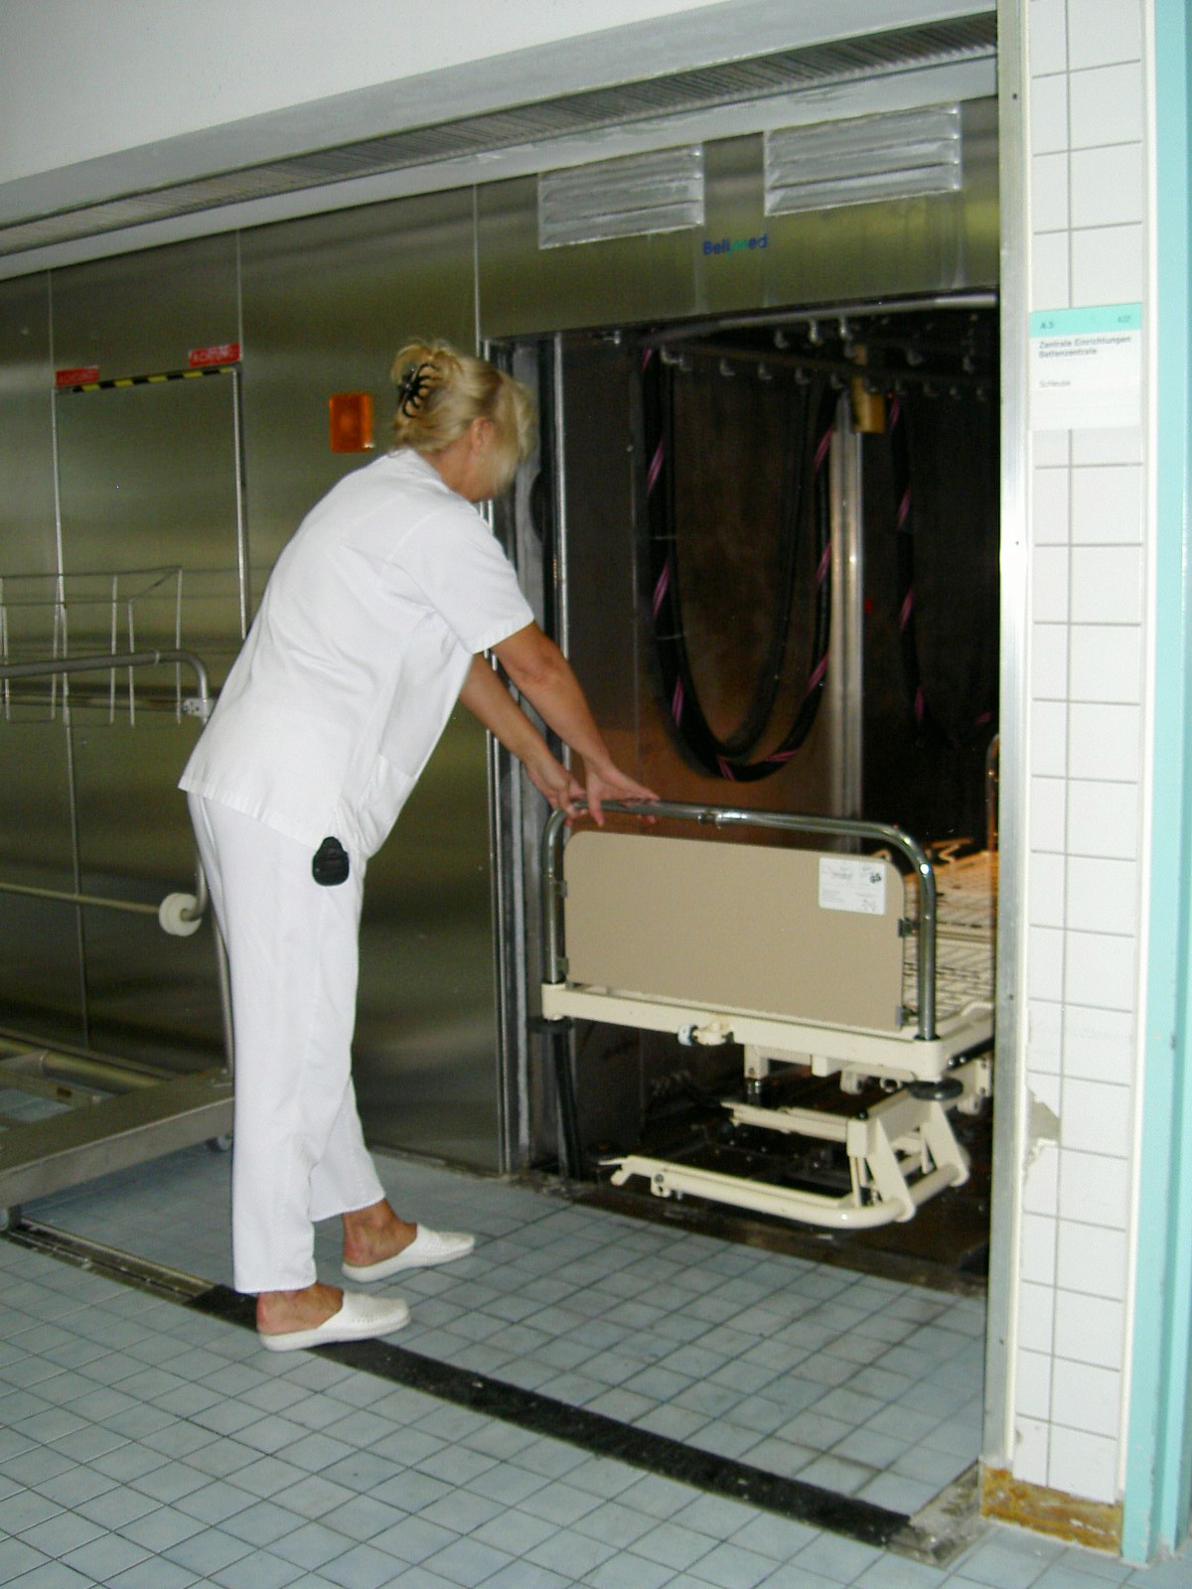
Washer disinfector for beds
Notes:
This device can be used to thoroughly clean beds between use.

Slide 30
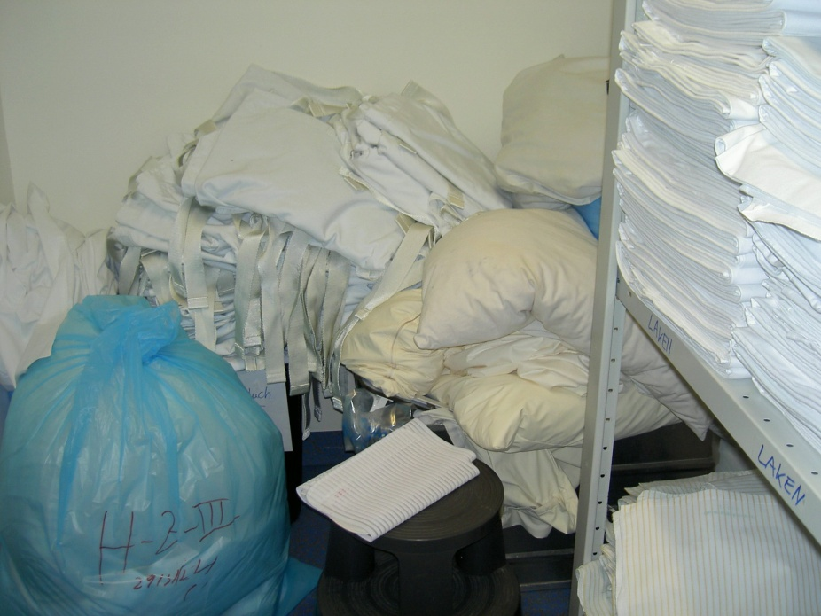
  Clean and dirty work in different rooms/areas
Notes:
No dirty clothes besides clean storage.

Slide 31
Resource considerations
How many day-care and out-patients will you serve?
How many in- patients, how sick are they and how long will they stay in hospital?
Patients will require more privacy for procedures
How much staff do you have per patient?
How many unqualified helpers?
Notes:
Factors /developments that should be considered for health care planning in medium and high income countries include:
The number of day-care and out-patients will increase.
Patients will stay in hospitals for shorter periods. On the other hand, patients in hospitals will be very sick and susceptible to infection and will need more care and more protection.
The number of diagnostic procedures will increase. Therefore, at the end of the day, the patient may require more rest and privacy.
People will get larger and more obese. Therefore, health care facilities need longer beds and stretchers, more square footage for rooms, doorways, and beds, and larger operating tables for heavy-weight persons.
Water purification plants for special units, such as haemodialysis and transplant wards, need careful maintenance to prevent growth of Legionella, Pseudomonas, moulds and other environmental microorganisms.

Slide 32
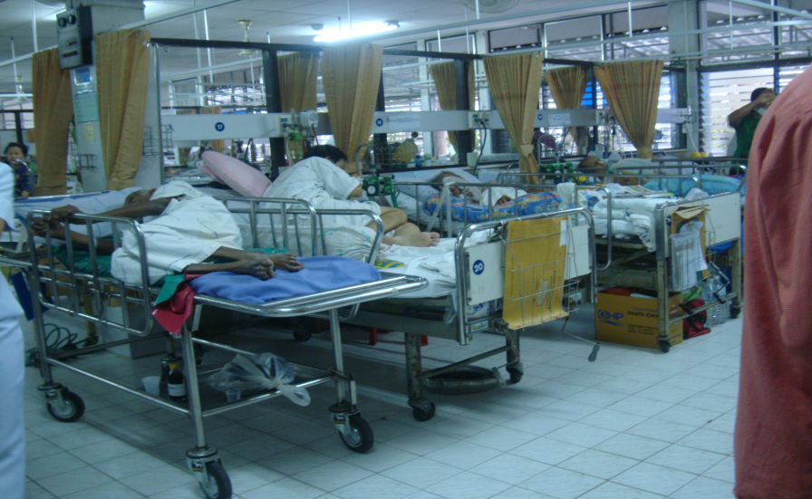
Infection prevention and control team - I
IP&C staff a link between medical personnel, architects and engineers
Prioritise areas with infection-prone patients:
  Operating and delivery rooms
  Intensive care units
  Emergency rooms
Notes:
Advice on construction must be a main focus for infection prevention and control (IP&C) staff. They should have a broad understanding of disease transmission and experience related to construction and renovation. Most countries have little or no training for engineers and architects in prevention of infection, and health care staff has limited experience with construction planning. IP&C staff can serve as a link between medical personnel, architects, and engineers.
Meetings for planning take up time, so IP&C staff need to prioritise. Areas where IP&C input is particularly important are those where many procedures are carried out and patients are prone to infection (operating and delivery rooms, intensive care units), and also those where many patients are congregated (emergency rooms).

Slide 33
Infection prevention and control team -2
Take part in the initial design of the building
Consider the flow of patients, staff and equipment
Get involved with the facility management
Notes:
Involvement with facility management staff during the initial design phase is the key to preventing and controlling airborne and waterborne contamination. Advice on building design, construction, and renovation is a critical task for IP&C staff. Well-constructed localities are needed to enable staff to follow IP&C guidelines.
Essential requirements for a health care facility include constant, reliable supplies of clean water and electricity, adequate numbers of beds and space between beds, good ventilation, and sufficient sanitation for patients, visitors and staff, and surfaces that can be cleaned and if needed, disinfected.

Slide 34
SIG construction recommendations - 2012
Design of a general ward
Protection of immunocompromised patients during building work
Emergency Unit
Design of Intensive Care Units
Design of a surgery block
Ventilation to prevent airborne transmission
Go to: www.theific.org
Notes:
In 2007, the IFIC Special Interest Group (SIG) “Design, construction and renovation” was founded. Its goal is to outline good practices for design, construction, and renovation. Another goal is to provide recommendations for low, medium, and high income countries.
Basic: even with severely limited resources, “this is what you should do as a minimum”.
Standard: “this is what you should aim for in less wealthy countries”.
Ideal: “if you have the resources, this is what you could do”.

Slide 35
References
CDC Guidelines for environmental infection control in health-care facilities. MMWR 2003, June 6, 1-42. http://www.cdc.gov/hicpac/pdf/guidelines/eic_in_HCF_03.pdf
Atkinson J, et al. Natural Ventilation for Infection Control in Health-Care Settings. World Health Organization 2009. http://www.who.int/water_sanitation_health/publications/natural_ventilation/en/
WHO policy on TB infection control in health-care facilities, congregate settings and households. World Health Organization, 2009. http://whqlibdoc.who.int/publications/2009/9789241598323_eng.pdf

Slide 36
References
Guidelines for drinking-water quality. 3rd edition. World Health Organization, 2008. http://www.who.int/water_sanitation_health/dwq/fulltext.pdf
Healthcare waste and its safe management, WHO, 2008. http://www.healthcarewaste.org/en/115_overview.html
Infection Control Principles for the Management of Construction, Renovation, Repairs and Maintenance within Health Care Facilities. Loddon Mallee Region Infection Control Resource Centre 2005. http://www.ihea.org.au/files/InfectionControlManual.pdf

Slide 37
Quiz
A key role of infection prevention and control in construction/renovation projects involves working with facility management staff during the initial design phase. T/F?
Potential building-related infection risks are
    Proximity of patients to each other
    Ease of carrying out best practices by staff
    Air/water quality
    All of the above
The following building factors influence spread of infections:
    Numbers of patients and staff
    Available space
    Number of beds in a room
    All of the above
Notes:
True
D
3. D

Slide 38
International Federation of Infection Control
IFIC’s mission is to facilitate international networking in order to improve the prevention and control of healthcare associated infections worldwide. It is an umbrella organisation of societies and associations of healthcare professionals in infection control and related fields across the globe .
The goal of IFIC is to minimise the risk of infection within healthcare settings through development of a network of infection control organisations for communication, consensus building, education and sharing expertise.
For more information go to http://theific.org/

