Slide 1
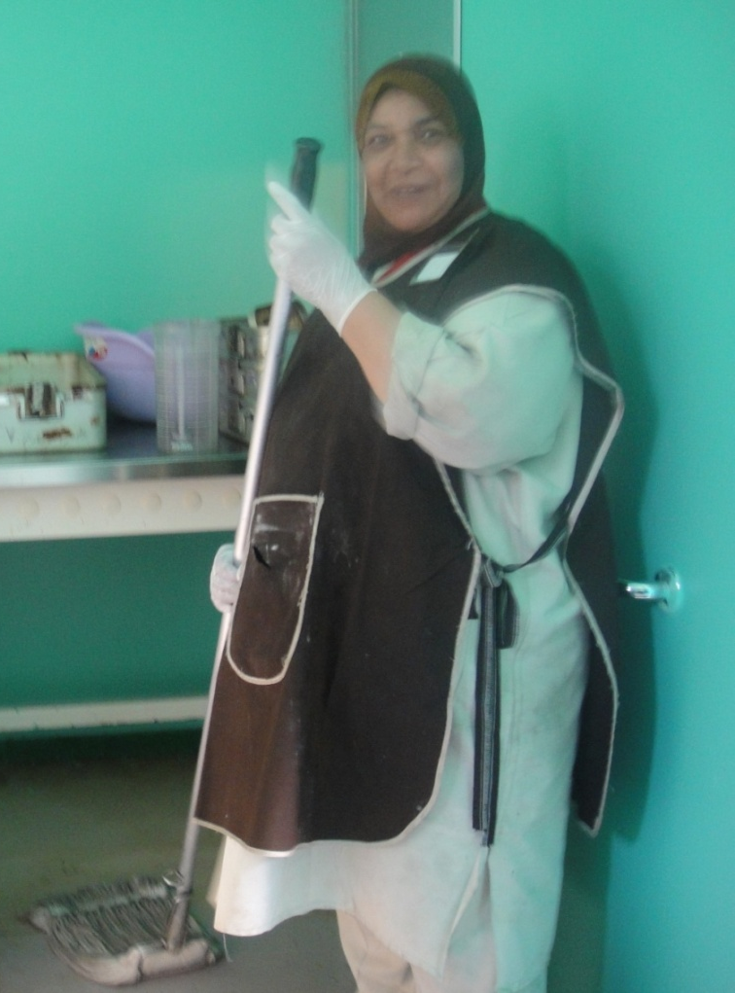
Housekeeping and laundry

Slide 2
Learning objectives
Identify the role of infection prevention and control in environmental services, housekeeping, and laundry settings.
Outline the role of chemicals, training, and work practices in infection prevention.
Explain the importance of the environment in infection prevention and control.

Slide 3
Time involved
35 minutes

Slide 4
Key Points
Cleaning performed using water and detergent
Neutral detergents adequate for most cleaning purposes
Cleaning staff must be properly trained and supervised
An ongoing cleaning schedule must be established
All linen, whether visibly soiled or superficially clean, must be processed to the same high standard
Notes:
The health-care facility should provide clean, hygienic conditions in the facility.

Slide 5
Sources of Infection
The infected patient is the primary source of infection
The inanimate environment is rarely the primary source of infection outbreaks
Contaminated water and bedding may result in opportunistic infections
Notes:
Risk factors that are associated with the inanimate environment, such as
the contamination of air, water or surfaces, play a minor role in most healthcare-associated infections.
Although microorganisms are ubiquitous in health care settings, inanimate materials are seldom responsible for the direct spread of infections. However, cleaning and maintenance prevent the build-up of soil, dust or other foreign material that can harbour microorganisms.
The number and type of microorganisms on surfaces are influenced by:
The number of people in the environment
The amount of activity in the environment
The amount of moisture (increased moisture favours the growth of Gram-negative bacteria)
The presence of material that can support microbial growth.
The type of surface

Slide 6
The Environment
Around an infected patient, the close environment may be contaminated by
Direct patient shedding
droplet-contact or airborne-contact)
Healthcare workers touching instruments, door knobs or other surfaces
indirect contact
Notes:
Droplet contact = infectious droplets are expelled, e.g., when sneezing or coughing. These droplets can fall on to surfaces.
Airborne contact = Small particles carrying microorganisms fall on to surfaces.
Indirect contact = Transfer of microorganisms through a contaminated intermediate object. May be due to inadequate hand hygiene, lack of equipment cleaning, etc.
Soiled items could contribute to secondary transmission by contaminating hands of healthcare workers or by contact with items that will subsequently come in contact with patients.
Strategies for cleaning should take into account the following areas:
The potential for direct patient contact
The degree and frequency of hand contact
The potential for contamination of the surface

Slide 7
Why Cleaning?
Clean the environment around discharged patients to prevent build-up of material that may harbour potential pathogens
A clean, well-maintained healthcare facility inspires confidence in patients, staff and the public
Dirt breeds dirt ...
Notes:
The transfer of microorganisms from surfaces is primarily through hand contact with the surface. Hand hygiene plus cleaning of surfaces is important in decreasing and potential contribution to healthcare-associated infections.
Cleaning is accomplished with water, detergents and mechanical action. Cleaning reduces or eliminates the reservoirs of potential pathogenic organisms.
The aim of cleaning is to achieve a clean environment with regular and conscientious general housekeeping.

Slide 8
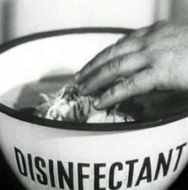
Disinfectants
Surface disinfectants
Chemical in nature
Hazardous and must be handled only by trained staff
Pose a risk to the environment
Use detergent/disinfectants that clean well and are not inactivated by organic matter
Notes:
Cleaning solutions and disinfectants must be diluted or activated according to product labeling. Staff should wear appropriate personal protective equipment, e.g., gloves, when using disinfectants.
Solutions after preparation should be used freshly then the remaining should be discarded. Storage of diluted solutions is prohibited.
Extraordinary measures do not need to be taken to disinfect the health care environment since the environment plays a minor role in healthcare-associated infections. There are a few disease exceptions that may require the use of disinfectants, e.g., an outbreak of C. difficile infections.

Slide 9
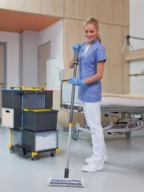
General Cleaning – 1
Vigorous cleaning with water and neutral detergents reduces or eliminates reservoirs of potential pathogens
Cleaners must be properly trained and supervised
An ongoing cleaning schedule must be established
Notes:
Surfaces must be cleaned immediately after soiling, such as with blood or body fluid. Use a cleaning pattern that progresses from clean areas to soiled areas. Do not re-dip cleaning cloths or mops to avoid contaminating the cleaning solution.

Slide 10
General Cleaning – 2
Visible dust and dirt should be removed
Duct, fan, and air conditioning systems should be cleaned on a routine basis
Keep housekeeping surfaces visibly clean on a regular basis
floors, walls, and tabletops
Clean up spills promptly

Slide 11
Cleaning Schedule - 1
Who is responsible for specific jobs
Work procedures, including special equipment and supplies
cleaning and storage of equipment
mop head changing
Use of protective clothing
Accountability
Notes:
Health care facilities should develop policies for cleaning schedules and methods, which should include who is responsible for which activities. There should be protocols outlining specific work procedures. These include:
Storage of equipment
Proper dilution of products used
Care of mop heads and cleaning cloths
When to wear protective clothing
Cleaning of patient rooms, operating theatre, treatment and sterile rooms, and other areas.

Slide 12
Cleaning Schedule -2
Frequency of
floor cleaning
solution and mop change
furniture cleaning
toilet, commode and fixture cleaning
cleaning fixtures such as ice machines
cleaning grilles and air-ducts
Notes:
The appropriate frequency of cleaning will depend on each care setting. Environmental surfaces, such as tables, exam tables, counters, overbed tables, arm rests, patient furniture, door handles, telephones and floors, in patient care areas should be cleaned daily.
During wet cleaning, cleaning solutions and the tools with which they are applied soon become contaminated. Therefore, a routine should be adopted that does not redistribute microorganisms. This may be accomplished by cleaning less heavily contaminated areas first and changing cleaning solutions and cloths/mops frequently. There should be a protocol outlining proper practices.
Tools used for cleaning or disinfecting must be cleaned and dried between uses. Prepare cleaning solutions daily or as needed, and replace with fresh solution frequently.

Slide 13
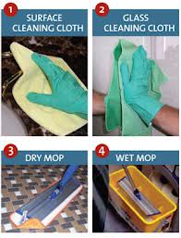
Cleaning items
Notes:
Household utility gloves should be worn during cleaning and disinfecting procedures.
Specific products may be required to clean glass.
Any dry cleaning should be done carefully with a chemically treated dry mop rather than a broom. Methods that minimise dust are preferred.
Damp rather than dry dusting or sweeping should be performed whenever possible.

Slide 14
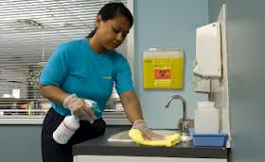
Cleaning Schedule -3
Walls do not need frequent cleaning
Floors and tables collect dust and need cleaning with water and detergent
Small surfaces frequently touched may need more frequent cleaning
Good hand hygiene is important
for nursing staff, cleaners, helpers,
and patients!
Notes:
Damp rather than dry dusting or sweeping should be performed whenever possible. Surfaces can be divided into those with
Minimal hand-contact (e.g., floors, walls)
Frequent hand-contact or ‘high-touch’ surfaces
High-touch surfaces = door knob, bed rail, light switches, area around the toilet, edges of privacy curtains. Because risk of spread of microorganisms is primarily through hands, high-touch surfaces should be cleaned more frequently than other surfaces.

Slide 15
Surface/object | Procedure
Horizontal surfaces | 1. Thorough regular cleaning 2. Cleaning when soiled 3. Cleaning between patients/clients and after discharge
Walls, blinds, curtains | Should be cleaned regularly with a detergent and as splashes/visible soil occur.
Floors | 1. Thorough regular cleaning 2. Cleaning when soiled 3. Cleaning between patients/clients and after discharge. Damp mopping preferred
Carpets/upholstery | Should be vacuumed regularly and shampooed as necessary.
Toilets and commodes | 1. Thorough regular cleaning 2. Cleaning when soiled 3. Clean between patients/clients and after discharge. Use a low level disinfectant.
From Infection Control Guidelines - Hand Washing, Cleaning, Disinfection and Sterilization in Health Care CCDR Supplement Volume 24S8, December 1998
Notes:
The frequency of cleaning or disinfecting the environment may vary according to the type of surface to be cleaned, the number of people and amount of activity in the area, the risk to patients and the amount of soiling. Horizontal surfaces have a higher number of microorganisms than vertical surfaces, ceilings and smooth intact walls and require more frequent cleaning.
Special cleaning practices may be required for isolation rooms, operating theatre, and areas with severely immunocompromised patients.

Slide 16
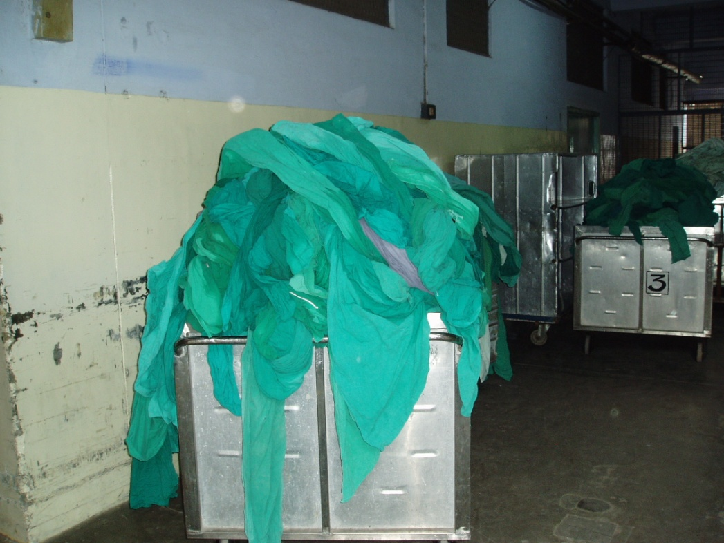
Laundry Services
Sorting procedures
Washing processes
Notes:
Laundry services provided either by the healthcare facility or an outside company need to follow the same infection prevention measures. General issues include:
Sorting of soiled linen on site and at the laundry
Transport of soiled linen
Washing linen
Storage of clean linen

Slide 17
Objectives
To prevent the transmission of infectious disease between patients and staff
To enhance patient comfort
To process all linen to the same high standard
To remove gross soil (e.g., faeces) by dumping it into a sluice, clinical sink, or down a toilet
Notes:
Linen from persons with a diagnosis of rare viral, hemorrhagic fevers (e.g., Lassa, Ebola, Marburg) requires special handling. See recommendations from the World Health Organization at http://www.who.int/csr/resources/publications/ebola/WHO_EMC_ESR_98_2_EN/en/index.html.

Slide 18
Sorting Procedures: In the Ward
Avoid contaminating hands with soil
Place soiled linen in a water-impermeable laundry bag
Secure bag when ¾ full
Leave bags in secure place for pick-up and transport
Beware of the risk to laundry workers from sharp objects left in soiled linen!
Notes:
All linen that is soiled with blood, body fluids, secretions or excretions or contaminated with lice or scabies should be handled using the same precautions, regardless of source or care setting. Linen should be handled with a minimum of agitation and shaking. Heavily soiled linen should be rolled or folded to contain the heaviest soil in the center of the bundle. Soiled linen should be bagged at the site of collection. A single, leak-proof bag or a single cloth bag can be used. Laundry carts or hampers used to collect or transport soiled linen need not be covered.
Staff in care areas need to be aware of sharp items when placing soiled linen in bags. Workers are at risk from contaminated sharps, instruments, or broken glass that may be contained with linen in the laundry bags.

Slide 19
Linen Transport
Bags should be tied securely and not over-filled when transported either by chute or cart
Notes:
When a laundry chute is used, all soiled linen must be securely bagged and tightly closed. Linen transported by cart should be moved in such a way that the risk of cross contamination is minimised. Carts used to transport soiled linen should be cleaned with the cleaning product used in the health care setting after each use.
Separate carts should be used for dirty and clean linens. Linen bags should be washed after each use and can be washed in the same cycle as the linen contained in them.

Slide 20
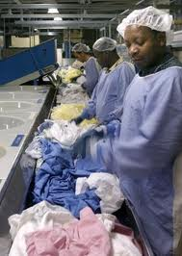
Sorting Procedures: In the Laundry
Sort laundry bags in area for dirty linen
Educate laundry sorters
Provide sorters with gloves and aprons/gowns
Presort soiled linen into washer loads
Minimise handling of soiled linen
Notes:
Workers should protect themselves from potential cross infection from soiled linen by wearing appropriate protective equipment, such as gloves and gowns or aprons, when handling soiled linen. All care givers and laundry workers should be trained in procedures for handling of soiled linen. Hand washing facilities should be readily available.

Slide 21
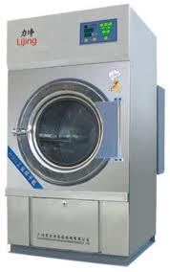
In the Washing Machine
Prewash rinse cycle 15 minutes
Wash in cold water wash, add bleach (2 mL/ litre of water) with detergent or
Wash at >71ºC if detergents with bleach are not used
Add souring agent during rinse cycle
Notes:
If low temperature water is used for laundry cycles, chemicals suitable for low temperature washing at the appropriate concentration should be used. To achieve a level of at least 100 ppm of residual chlorine with household bleach, 2 mL of household bleach should be added for every litre of water. High temperature washes (> 71.1ºC) are necessary if cold water detergents are not used.
Addition of a mild acidic “souring” agent neutralises the alkalinity from the fabric, water and detergent. This shift in pH from approximately 12 to 5 may inactivate any remaining bacteria and reduce the potential for skin irritation.

Slide 22
Handling after Washing
Dry linen soon after washing to prevent any regrowth of bacteria
Hot air drying or drying on a clothesline in sunlight reduces numbers of bacteria
Ironing will destroy pathogens
especially using a steam iron

Slide 23
Storage and Packaging
Store and transport clean linen so that contamination is avoided
Wrap linen to be sterilised appropriately
Notes:
Clean linen should be transported and stored in a manner that prevents its contamination and ensures its cleanliness. Only surgical gowns and linens used in sterile procedures need to be sterilised.

Slide 24
Role of Infection Prevention & Control
Help perform a risk assessment to identify high-touch surfaces
Provide advice on cleaning strategy and schedules
Evaluate products
Especially any disinfectants

Slide 25
References
Malik RE, et al. Use of audit tools to evaluate the efficacy of cleaning systems in hospitals. Am J Infect Control 2003; 31:181-7.
Dettenkofer M, et al. Does disinfection of environmental surfaces influence nosocomial infection rates? Am J Infect Control 2004; 32(2):84-9.
Spencer RC. Importance of environmental decontamination--a critical view. J Hosp Infect 2007; 65 (Suppl 2):55-7.

Slide 26
Quiz
A key role of infection prevention and control in housekeeping/laundry involves working with staff on safe practices. T/F?
Potential housekeeping-related infection risks are
Proximity of patients to each other
An infected patient
Air quality
All of the above
Cleaning influences the spread of infections by:
Decreasing soil that might carry pathogens
Dry dusting walls
The type of carpet in patient rooms
All of the above
Notes:
True
B
3. A

Slide 27
Quiz
Proper storage of clean linen includes
Avoiding contamination
Use of a single storage space
Separation from soiled linen
All of the above
Handling linen properly influences the spread of infections by:
Removing gross soil
Use of bleach
Washing at >71°C
All of the above
Notes:
4. A, C
5. D

Slide 28
International Federation of Infection Control
IFIC’s mission is to facilitate international networking in order to improve the prevention and control of healthcare associated infections worldwide. It is an umbrella organisation of societies and associations of healthcare professionals in infection control and related fields across the globe .
The goal of IFIC is to minimise the risk of infection within healthcare settings through development of a network of infection control organisations for communication, consensus building, education and sharing expertise.
For more information go to http://theific.org/

