Slide 1
Isolation Precautions

Slide 2
Learning objectives
Explain the rationale for isolation precautions.
Outline the types and indications of isolation precautions.
List the types of personal protective equipment used in isolation precautions.

Slide 3
Time involved
35 minutes

Slide 4
Key points
Microorganisms can be spread from patients to patients and patients to staff
Isolation precautions can reduce transmission decreasing the spread of microbes
Components: hand hygiene, personal protective equipment, single rooms, ventilation, and restriction of movement
Must be applied according to signs and symptoms
Notes:
Microorganisms causing healthcare-associated infections can be spread from infected or colonised patients to other patients and to staff. Appropriate isolation/precautions can reduce transmission if they are applied properly. An isolation/precautions policy aims to decrease the spread of infectious agents between staff and patients to such a level that infection or colonisation does not occur.
Isolation/precautions policies have several parts: hand hygiene, personal protective equipment (protective clothing and other items), single rooms with more or less sophisticated ventilation, and restrictions for movement of patients and staff. Apply isolation/precautions according to signs and symptoms of the patient; in general, do not wait for laboratory results.

Slide 5
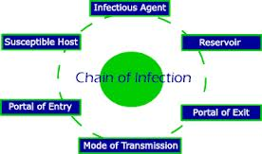
Chain of Infection
Infection results from an interaction between an infectious agent and susceptible host
The interaction occurs by means of contact between the agent and the host and is affected by the environment
Breaking the chain of infection by interrupting transmission is generally the best way to prevent infections
Notes:
Infection results from an interaction between an infectious agent and susceptible host. This interaction occurs by means of contact between the agent and the host and is affected by the environment. Breaking the chain of infection by interrupting transmission is generally the best way to prevent infections.
The chain of infection consists of the following components: infectious agent, reservoir, portal of exit, mode of transmission, portal of entry and susceptible host. Isolation precautions focuses on interrupting this chain of infection, especially transmission.

Slide 6
Transmission of Infections - 1
Contact spread
Direct: from one person to another
Indirect: contaminated equipment or surfaces
Droplet
Expelled when sneezing or coughing; less than 2m from the source
Notes:
A pathogen may be transmitted by a single route or it can be transmitted in several ways.
Contact spread
Direct contact occurs when microorganisms are transferred from one person to another. It can involve contact with blood, body fluids, excretions, or secretions:
During patient care by the healthcare worker or a visitor or family member.
During interactive activities in playrooms or lounges between patients.
Indirect contact involves the transfer of a microorganism through a contaminated intermediate object, substance, or person, e.g., contaminated equipment, food, water, or supplies. May occur when
Inadequate hand washing is performed by a care provider.
Equipment is not cleaned, disinfected, or sterilised adequately between patients.
Bloodborne pathogens are transferred by sharps or needle-stick injuries, transfusion, or injection.
Droplet spread: Infectious droplets that are expelled, e.g., when sneezing or coughing, are too heavy to float in air and can be transferred less than 2m from the source of the droplets. Spread may be direct or indirect.
Direct droplet transmission. Droplets reach mucous membranes or are inhaled.
Indirect droplet transmission. Droplets fall on to surfaces or hands and are transmitted to mucous membranes or food. Indirect droplet transmission is often more efficient than direct transmission.
Infections spread this way include the common cold, influenza, and respiratory syncytial viruses.

Slide 7
Transmission of Infections - 2
Airborne spread
Small particles (≤5μm in size) can remain airborne
Transferred more than 2m from the source
Vehicle spread
Vector-borne
Notes:
Airborne spread
Small particles (≤5μm in size) carrying microbes can remain airborne; they may be transferred via air currents for more than 2m from the source as droplet nuclei or on skin scales. These particles are then inhaled. Examples of microbes spread in this manner are varicella zoster, measles, and pulmonary tuberculosis.
Vehicle spread
Vehicle transmission applies to microorganisms transmitted through contaminated items such as food, water, medications, medical devices and equipment, toys, and biological products, such as blood, tissues or organs.
Vector-borne
Vector-borne transmission occurs when vectors such as mosquitoes, flies, rats, and other vermin transmit microorganisms. Transmission occurs through simple contamination by animal or arthropod vectors or their actual penetration of the skin or mucous membranes. This mode of transmission plays a minor role in transmission of HAIs.

Slide 8
Principles of Isolation
Understand what is to be achieved through isolation
Know the route of transmission of an infectious agent
Reduce risks
Emphasise the use of protective barriers
Notes:
With the constant emergence of new pathogens, the management of infected patients in the health care setting becomes extremely important. The fundamental principles of managing patients with a transmissible infection are:
What is to be achieved by using isolation/precautions (IP)
Knowledge of the route of transmission of an infectious agent
How to reduce risks between patients, and between patients and healthcare workers (HCW)

Slide 9
Background
Universal Precautions created in 1985 due to AIDS epidemic
Objective was to prevent infections transmitted by blood and body fluids
Concept of Body Substance Isolation published in 1987
All fluids from patients handled using gloves
Notes:
Since hospitals began to segregate patients with potentially transmitted pathogens, different types of isolation precautions (IP) have been recommended. Before 1900, infected patients were segregated in separate wards depending on their diseases. After 1900, the emphasis was on the use of protective barriers for healthcare workers (HCW) treating patients with specific diseases
In 1985, the concept of Universal Precautions (UP) was created, primarily due to the acquired immune deficiency syndrome (AIDS) epidemic. The objective was to prevent infections transmitted by blood and body fluids between patients and HCWs. These recommendations had a great impact because they were the first directed toward HCW protection. For the first time, emphasis was placed on precautions for all persons, regardless of their presumed infection status.
The idea underlying Body Substance Isolation (BSI) was published in 1987; it is similar to UP. All fluids coming from patients must be handled with gloves. It doesn’t consider other barriers or additional practices to prevent sharps injuries. The main problem with BSI is overuse of gloves or performing patient care without changing gloves when needed. There is also less hand washing due to the perceived security of gloving, together with an increase in latex dermatitis due to glove use.
IP concepts have evolved over the years due to novel microorganisms (HIV, SARS) and emergence of multidrug-resistant bacteria.

Slide 10
Isolation Precautions
Standard Precautions
Transmission-based Precautions
Notes:
There are two tiers of precautions to prevent transmission of infectious agents, Standard Precautions and Transmission-Based Precautions.
Standard Precautions are intended to be applied to the care of all patients in all healthcare settings, regardless of the suspected or confirmed presence of an infectious agent. Implementation of Standard Precautions constitutes the primary strategy for the prevention of healthcare-associated transmission of infectious agents among patients and healthcare personnel.
Transmission-Based Precautions are for patients who are known or suspected to be infected or colonised with infectious agents, including certain epidemiologically important pathogens, which require additional control measures to effectively prevent transmission. Since the infecting agent often is not known at the time of admission to a healthcare facility, Transmission-Based Precautions are used empirically, according to the clinical syndrome and the likely etiologic agents at the time, and then modified when the pathogen is identified or a transmissible infectious aetiology is ruled out.

Slide 11
Standard Precautions - 1
Basic precautions recommended for all patients
Also called Routine Practices
Based in the fact that unsuspected agents may be present in body fluids, non-intact skin and mucous membranes of all patients
Notes:
Basic hygienic precautions are recommended for all patient encounters. These precautions are often called Standard Precautions or Routine Practices. Because unsuspected infectious agents may be present in blood and most body fluids and on non-intact skin and mucous membranes of all patients, hand hygiene and personal protective equipment (PPE) (e.g., gloves, gown, mask, and eye/face protection) should be used if contact with those substances is likely.

Slide 12
Standard Precautions - 1
Hand hygiene
Disposable gloves on contact with secretions, excretions, or body fluids
Protective apron or gown for body contact with patient or patient’s bed
Appropriate handling of equipment and linen
Environmental cleaning and spills-management
No cap, mask, or shoe covers
Notes:
Includes:
Hand disinfection with alcohol-based hand rubs or soap and water.
Disposable gloves on contact with secretions, excretions, or blood/ body fluids.
Protective apron or gown for body contact with patient or patient’s bed.
Appropriate handling of patient care equipment and soiled linen.
Environmental cleaning and spills-management.
No cap, mask, or shoe covers are needed.

Slide 13
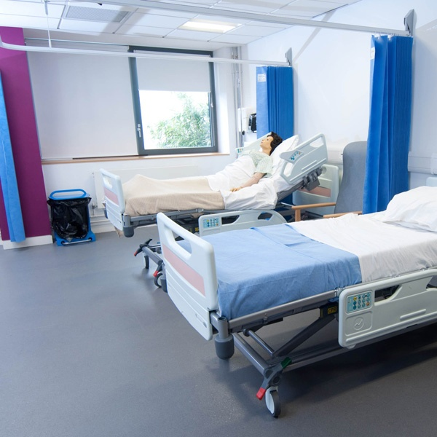
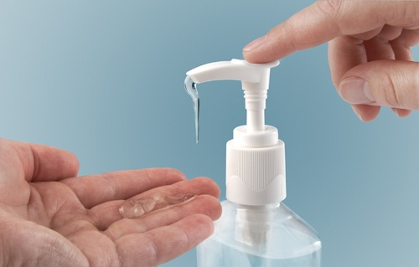
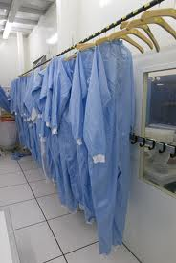
Structural Elements
Notes:
Space between beds has been shown to be important in transmission of microorganisms. Beds should be at least far enough apart that a nurse cannot touch both beds at the same time. Increasing the distance decreases the risk of transfer of pathogens, which may be directly related to overcrowding.
Sinks are needed for good hand hygiene; hands should be washed when visibly dirty. However, hand hygiene has not been improved by installing more than one sink per six patient beds. Dispensers for alcohol-based hand rub must be available and placed within easy reach.
A separate gowning area may be useful.

Slide 14
Additional transmission-based precautions
Contact precautions
Droplet precautions
Airborne Isolation
Protective Isolation
Notes:
There are additional precautions based on the route of transmission of selected microorganisms. They are:
Contact precautions
Droplet precautions
Airborne Isolation
Protective Isolation

Slide 15
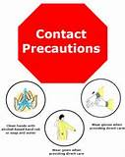
Contact Precautions
PPE when likely to be in contact with environment contaminated with agents such VRE, MRSA or Clostridium difficile
Single room or room with another patient infected by the same pathogen
Clean gloves when entering the room
Clean gown/apron if substantial contact with the patient or environment is anticipated
Notes:
Contact precautions. Includes use of personal protective equipment (PPE) when a caregiver is likely to be in contact with an environment contaminated with microbes such as vancomycin-resistant Enterococcus (VRE), methicillin-resistant Staphylococcus aureus (MRSA), or Clostridium difficile. Place patient in a single room or in a room with another patient infected by the same pathogen. Wear clean gloves when entering the room and a clean gown/apron if substantial contact with the patient, environmental surfaces, or items in the patient’s room is anticipated.

Slide 16
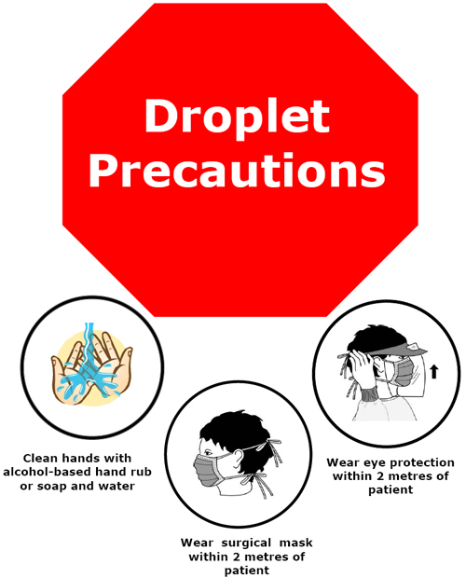
Droplet Precautions
Single room or in a room with another patient infected by the same pathogen
Face protection when working within 1-2 metres of the patient
Mask on the patient if transport is necessary
Indications: Respiratory diseases (RSV, Influenza)
Notes:
Droplet precautions. Place patient in a single room or in a room with another patient infected by the same pathogen. Wear face protection when working within 1-2 metres of the patient. Place a mask on the patient if transport is necessary.

Slide 17
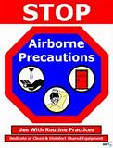
Airborne Isolation
Single room most important
Mask or respirator when entering room
Mask on patient if transport necessary
Recommended
Negative air pressure relative to corridors
Air exhausted directly to the outside or recirculated through HEPA filtration (6 - 12 air changes per hour)
Indications: Tuberculosis, rubeola
Notes:
Airborne Isolation/Precautions. Simply placing the patient in a single room (including bathroom facilities) reduces the risk of transmission. However, an isolation room with negative air pressure relative to corridors, air exhausted directly to the outside or recirculated through high efficiency particulate air (HEPA) filtration with 6 - 12 air changes per hour is recommended. A mask or respirator should be worn by all staff who enter the room.

Slide 18
Protective Isolation
Recommended only for allogeneic hematopoietic stem cell transplant patients
Positive room air pressure relative to corridors, along with HEPA filtration of incoming air at ≥12 air changes per hour
Appropriate engineering controls
Consider:
Single rooms with negative or positive pressure very difficult to maintain
Rooms with anterooms have less air movement
Notes:
Protective Isolation. Positive room air pressure is required, relative to corridors, along with HEPA* filtration of incoming air at ≥12 air changes per hour.
Protective Isolation is recommended only for allogeneic hematopoietic stem cell transplant patients; it requires appropriate engineering controls to prevent exposure to environmental fungal spores.
Single rooms with negative or positive air pressure are very difficult to maintain. In single rooms with ventilated anterooms (airlocks), the risk of air movement between room and corridor is minimised. This system is easier to maintain; however it is costly to build.
*High-efficiency particulate air

Slide 19
Essential Components - 1
Hand hygiene
Especially important after contact with patients and contaminated equipment or surfaces
Staff equipment and surfaces
Keep clean
Handle patient equipment with care
Ensure all reusable equipment is reprocessed
Linen
Handle, transport, and process with care
Notes:
There are essential components for all types of isolation precautions. These are:
Hand hygiene
Good hand hygiene reduces the number of microorganisms found on the hands during daily duties and is especially important after contact with blood, body fluids, secretions, excretions, and contaminated equipment or surfaces.
Equipment and surfaces
Cleanliness is one of the main objectives of infection prevention and control. Handle patient care equipment soiled with blood, body fluids, secretions or excretions with care to prevent exposure to skin and mucous membranes, clothing, or the environment. Ensure all reusable equipment is cleaned and reprocessed appropriately before being used on another patient.
Linen
Handle, transport, and process linen that is soiled with blood, body fluids, secretions, or excretions with care to ensure that there is no leaking of fluid.

Slide 20
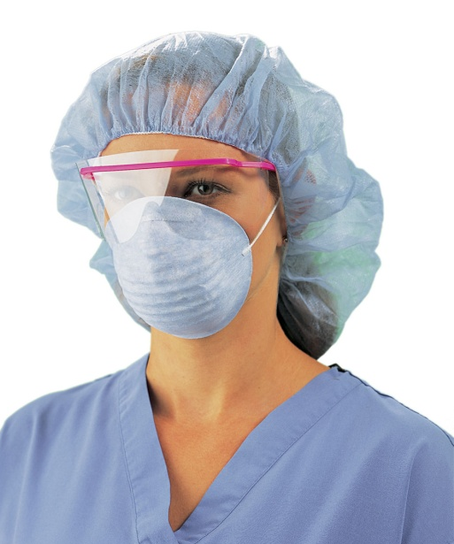
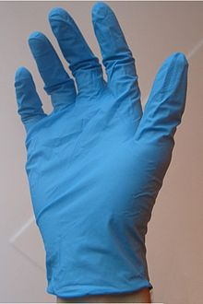
Essential Components - 2
Personal protective equipment
Gloves
Change between patients
Remove immediately after use
Do not reuse
Clothes
Remove if soiled or wet as soon as possible
Masks, goggles, visors, respirators
Protect against blood/ body fluid splashes
Disinfect as needed
Notes:
Personal protective equipment (PPE)
Using PPE provides a physical barrier between microorganisms and the wearer. It offers protection by preventing microorganisms from contaminating hands, eyes, or clothing and then being spread to other patients and staff.
Gloves
Wear clean gloves when touching blood, body fluids, secretions, excretions, or mucous membranes. Change gloves between patients and different tasks/procedures on the same patient to prevent cross-contamination between body sites. Remove gloves immediately after use. Disposable gloves should not be reused.
Clothes
Contamination of work clothes can be considerable (from splashes or spills of body fluids) and is reduced by a protective gown or apron. Wearing a plastic apron during nursing/clinical procedures reduces the risk of transmission. Remove a soiled or wet gown as soon as possible. If it is necessary to use the gown/apron later again on the same patient, remove it without touching the outer side.
Masks
Mask, goggles, and/or visors protect mucous membranes against blood/ body fluid splashes. A respirator may provide useful protection against tuberculosis. Disinfect items as needed.

Slide 21
Essential Components - 3
Family members providing care to patients MUST be educated
Practice good hygiene
Use appropriate precautions to prevent spread of infections
Precautions for family members should be the same as those used by staff
Notes:
Family members providing care to patients
Family members providing care to patients MUST be educated by the staff to use good hygiene and appropriate precautions to prevent spread of infections to themselves and to other patients. The precautions for the family members should be the same as those used by staff.

Slide 22
Considerations about Isolation Precautions
In most cases, Standard Precautions are sufficient
Base on clinical signs and symptoms
Consider:
Single room when gross contamination of the environment is likely (e.g., wounds, diarrhoea, bleeding)
Door closed when contact transfer is likely (e.g., injured skin)
Ventilate to the outside when airborne transfer is likely (e.g., tuberculosis)
Use airlock when massive airborne transfer is likely (e.g., varicella)
Notes:
In most cases, use of Standard Precautions is sufficient. IP should primarily be based on clinical signs and symptoms. When isolation precautions is needed, the following practices should be considered:
Single room (including bathroom) when gross contamination of the environment is likely (e.g., large wounds with heavy discharge, massive uncontrolled bleeding, diarrhoea)
Single room, door closed when contact transfer is likely (e.g., injured skin with Gram positive infection)
Single room ventilated to the outside when airborne transfer is likely (e.g., tuberculosis)
Single room with airlock when massive airborne transfer is likely (e.g., varicella)
Use of a single room is not the whole solution to preventing spread of infections. Barrier practices must be adhered to as well.

Slide 23
General Recommendations - 1
Isolation Precautions is associated with adverse psychological effects
Discontinued as soon as possible
Fluids of all patients are potentially infectious
Hand Hygiene is a key component
Use a no-touch technique when possible
Notes:
Isolation precautions is associated with adverse psychological effects as well as decreased physician contact and other adverse effects, so it should be discontinued as soon as possible. Regard all patient blood/body fluids, excretions, and secretions as potentially infectious and institute appropriate precautions to minimise risks of transmission of infection.
Decontaminate hands between each patient contact. Wash hands promptly after touching potentially infective material (blood, body fluids, secretions, or excretions). Use a no-touch technique when possible to avoid touching infective material.
Wear gloves, if available, when in contact with blood, body fluids, secretions, excretions, and contaminated items. Disinfect hands immediately after removing gloves. (If gloves MUST be re-used, dip the gloved hand into dilute bleach [1:100]. If soiled, wash with soap and water first.)
Dispose of faeces, urine, and other patient secretions via designated sinks, and clean and disinfect bedpans, urinals, and other containers appropriately. Clean up spills of infective material promptly. General disinfection of floors and walls is then not necessary. Ensure that patient-care equipment, supplies, and linen contaminated with infective material is cleaned and/or disinfected between each patient use.
For tuberculosis patients – develop a protocol outlining methods for separation of patients, type of ventilation (e.g., natural or negative pressure), and use of masks.

Slide 24
General Recommendations - 2
Dispose of faeces, urine, and secretions via designated sinks, and clean and disinfect containers
Clean up spills promptly
Ensure that patient-care equipment, supplies, and linen is cleaned and/or disinfected between each use
For tuberculosis patients – develop a protocol
Notes:
Isolation precautions is associated with adverse psychological effects as well as decreased physician contact and other adverse effects, so it should be discontinued as soon as possible. Regard all patient blood/body fluids, excretions, and secretions as potentially infectious and institute appropriate precautions to minimise risks of transmission of infection.
Decontaminate hands between each patient contact. Wash hands promptly after touching potentially infective material (blood, body fluids, secretions, or excretions). Use a no-touch technique when possible to avoid touching infective material.
Wear gloves, if available, when in contact with blood, body fluids, secretions, excretions, and contaminated items. Disinfect hands immediately after removing gloves. (If gloves MUST be re-used, dip the gloved hand into dilute bleach [1:100]. If soiled, wash with soap and water first.)
Dispose of faeces, urine, and other patient secretions via designated sinks, and clean and disinfect bedpans, urinals, and other containers appropriately. Clean up spills of infective material promptly. General disinfection of floors and walls is then not necessary. Ensure that patient-care equipment, supplies, and linen contaminated with infective material is cleaned and/or disinfected between each patient use.
For tuberculosis patients – develop a protocol outlining methods for separation of patients, type of ventilation (e.g., natural or negative pressure), and use of masks.

Slide 25
Guidelines
Australian Guidelines for the Prevention and Control of Infection in Healthcare, 2010. http://www.nhmrc.gov.au/node/30290
Hospital infection control guidance (SARS), Health Protection Agency, UK, 2005. http://www.hpa.org.uk/web/HPAwebFile/HPAweb_ C/1194947350823
Routine Practices and Additional Precautions in All Health Care Settings, 2012, Canada http://www.publichealthontario.ca/en/eRepository/RPAP_All_HealthCare_Settings_Eng2012.pdf

Slide 26
References
Infection prevention and control of epidemic- and pandemic-prone acute respiratory diseases in health care. Interim WHO Guidelines, June 2007. http://whqlibdoc.who.int/hq/2007/WHO_CDS_EPR_ 2007.6_eng.pdf
CDC Guideline for isolation precautions: Preventing transmission of infectious agents in healthcare settings. (HICPAC), 2007. http://www. cdc.gov/hicpac/pdf/isolation/Isolation2007.pdf
Practical Guidelines for Infection Control in Health Care Facilities. WHO. 2004. http://www.searo.who.int/entity/emergencies/documents/infectioncontrolfullmanual.pdf

Slide 27
Further Reading
Global alert and response: infection prevention and control in healthcare. WHO. 2011. http://www.who.int/csr/bioriskreduction/ infection_control/en/
WHO Interim Infection control recommendations for care of patients with suspected or confirmed filovirus (Ebola, Marburg, haemorrhagic fever.), 2008 http://www.who.int/csr/bioriskreduction/filovirus_ infection_control/en/index.html
Notes:
Canada has an online infection prevention and control learning presentation that might be useful for instructors. ​​This presentation describes the various components of Routine practices in infection prevention and control. http://www.publichealthontario.ca/en/BrowseByTopic/InfectiousDiseases/Pages/Routine_Practices.aspx

Slide 28
Quiz
In general, Standard Precautions are sufficient to prevent spread of microorganisms. T/F?
Which of the following is NOT a key component of isolation precautions:
Hand Hygiene
Separation of beds
Surveillance
Personal protective equipment
In a case of tuberculosis you should use:
Contact isolation
Airborne isolation
Droplet isolation
Protective isolation
Notes:
True
C
3. B

Slide 29
International Federation of Infection Control
IFIC’s mission is to facilitate international networking in order to improve the prevention and control of healthcare associated infections worldwide. It is an umbrella organisation of societies and associations of healthcare professionals in infection control and related fields across the globe .
The goal of IFIC is to minimise the risk of infection within healthcare settings through development of a network of infection control organisations for communication, consensus building, education and sharing expertise.
For more information go to http://theific.org/

